Slide 2
Open Spec for Iin Calibration

Slide 3
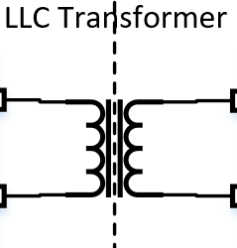
DCDC Design
Not avail on CAN;
No cust spec
Internal spec: +/-0.5A
CAN;
No sensor; computed
Customer spec : -20A for Iout in [0;30]A
-10A for Iout in [30;100]A
-7A for Iout>100A
Not avail on CAN;
Not calibrated
Iin
Ireso (LLC)
Iout
Pin
EMI Input Filter
Booster
LLC Primary
LLC Rectifier
EMI Output Filter
CAN;
Cust spec: +/- 0.2kW
V_bulk
V_in
V_out
CAN;
Cust spec: +/- 6V
No CAN;
Cust spec: +/- 6V
Monitored by vehicle system
Iin
Impact on Pin measurement → no diag on system
Impact on Iout measurement → no direct diag
Impact on Plausibility diag → car alert due to difference in Iout(I_LLC) and Iout(Iin)
No Functional derating in case of Fault Detection, unit just raises the alert.
Due to DCDC_ElecSysFailureDisplay = Alert, the customer is alerted and the DCDC changed in the shop

Slide 4
Plausibility Issue
March2020
May2023
May-June2023
Feb-March2024
Release of ATS spec (0.5A) and program using Vector
Customer Alert
DCDC raised plausibility error due to Iin-Offset (~2A for no current)
Quality Alert and Analysis; sorting activity for units with Iin-Offset >0.81A
ATS3 screening implementation: check of offset value at 0A (<0.81A)
Increase demand from customer → request from production to open limits
Analysis show ATS1 limit has been increased to 2A
0.81A value calculated based on Iout spec
Units failed at ATS3 are being reworked by changing the IC
Analysis Plausibility DTC:
Worst case 3 units
Iin Offset 1.71A; 1.28A; 1.32A;
PTL with 21.35.00
PTL with 23.15.00
No fault raise
Vout, Vin, Iout in spec
Analysis impact on Iout meas:
Iin tolerance can increase to 1.3A
SW 20.40.00 → as in TDR (th =50A)
SW 21.35.00 → as in TDR (th =50A)
SW 23.15.00 → Detection increased to 80A; masked for Iin <3A
SW 23.39.00 → DCDC_ElecSysFailureDisplay= Alert, deleted

Slide 5
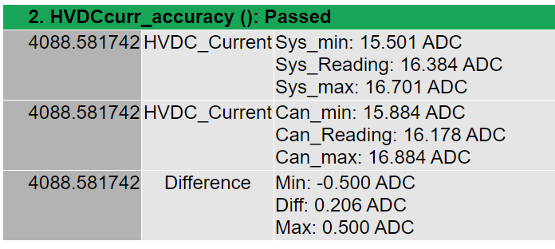
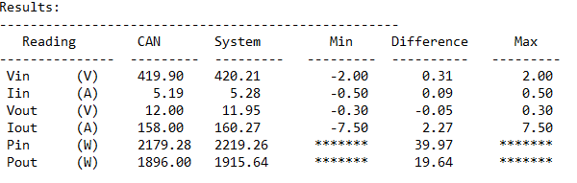
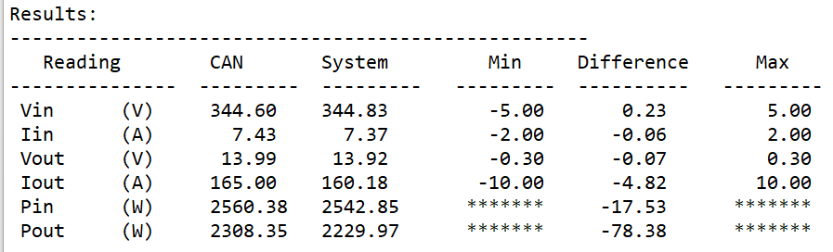
ATS – Testing and Reporting
ATS designed in 2020 in DES for step1S for Vector Tools
DET refused to implement Vector and switched to Chroma – they adapted the tests provided from DES
After checking first reports, there were a few modification recommended in 2021-2022 because a lot of the tests were redunded and had no pass/fail criteria implemented
Both these ATE program have a limit of 0.5A implemented for input current accuracy checking
New ATE reports from 08.2022 (for both of failed units) have the input current threshold increased to 2A
Report from Vector
Report from 05.05.2022
Report from 06.08.2022

Slide 6
Thank you!
Name:
Email:
Phone:
www.delta-emea.com

